Slide 1
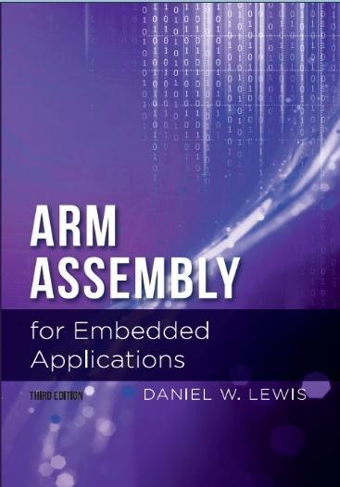
Chapter 10
Working with Fixed-Point Real Numbers

Slide 2
What Are Fixed-Point Reals?
A way to represent a real number using an integer.
Integers imply a binary point at the far right.
Binary point far right: 00101101. → +45₁₀
We can imagine the binary point to be anywhere:
Binary point midway: 0010.1101 → +2.8125₁₀

Slide 3
Why Fixed-Point Reals?
Many inexpensive CPU chips designed for embedded applications do not have a hardware Floating-Point Unit (FPU).
Software libraries that emulate a FPU can be used but are very slow.
Many embedded applications are multi-threaded. Using a FPU significantly increases the context-switch time.

Slide 4
Q FORMAT AND THE IMAGINARY BINARY POINT
A way to specify the position of the binary point
“Q” followed by the number of bits to the right of the binary point:
Sometimes use Qm.n, where m = # integer bits and n = # fractional bits.
Integer | Q | Implied | Interpretation
+71₁₀ (01000111₂) | Q0 | 01000111. | +71/2⁰ | = | +71.00000₁₀
 | Q3 | 01000.111 | +71/2³ | = | +8.87500₁₀
−57₁₀ (11001000₂) | Q2 | 110001.11 | −57/2² | = | −14.25000₁₀
 | Q5 | 110.00111 | −57/2⁵ | = | −1.78125₁₀
Q8.0
Q5.3
Q6.2
Q3.5

Slide 5
ADDITION AND SUBTRACTION OF FIXED-POINT REALS
Easy as long as operands have same Q format
Just use regular integer addition or subtraction:
Operand | Integer | Q | Interpretation
A | +30₁₀ | Q3 | +30/2³ | = | +3.75₁₀
B | −54₁₀ | Q3 | -54/2³ | = | −6.75₁₀
Result | Integer | Q | Interpretation
A+B | −24₁₀ | Q3 | -24/2³ | = | −3.00₁₀
A−B | +84₁₀ | Q3 | +84/2³ | = | +10.50₁₀

Slide 6
ADDITION AND SUBTRACTION OF FIXED-POINT REALS
Must pre-align operands w/different Q formats must be
Shift the operand w/fewer fractional bits left:
Operand | Integer | Q | Interpretation
A | +30₁₀ | Q3 | +30/2³ | = | +3.75₁₀
B | −54₁₀ | Q5 | -54/2⁵ | = | −1.6875₁₀
Operand | Integer | Q | Interpretation
A | +120₁₀ | Q5 | +120/2⁵ | = | +3.75₁₀
B | −54₁₀ | Q5 | -54/2⁵ | = | −1.6875₁₀
Result | Integer | Q | Interpretation
A+B | +66₁₀ | Q5 | +66/2⁵ | = | +2.0625₁₀

Slide 7
MULTIPLICATION OF FIXED-POINT REALS
Consider what happens when you multiply two decimal reals:
1.53
×2.3
153
×23
459
306
3519
The digits of the product are determined without regard to the decimal points.
Then the decimal point is inserted so that the number of fractional digits is the sum of those in the two operands.
3.519

Slide 8
MULTIPLICATION OF FIXED-POINT REALS
Same as in decimal, but Q format changes
The number of fractional bits in the product is the sum of those in the operands.
Operand | Integer | Q | Interpretation
A | +30₁₀ | Q3 | +30/2³ | = | +3.7500₁₀
B | +51₁₀ | Q2 | +51/2² | = | +12.7500₁₀
Result | Integer | Q | Interpretation
A×B | +1530₁₀ | Q5 | +1530/2⁵ | = | +47.8125₁₀

Slide 9


INTEGER DIVISION
In integer division, the radix point of all operands is at the far right.
31 |  |  |  |  |  |  |  |  |  |  |  |  |  |  | 16 | 15 |  |  |  |  |  |  |  |  |  |  |  |  |  |  | 0
Dividend:
Radix point
$$÷$$
15 |  |  |  |  |  |  |  |  |  |  |  |  |  |  | 0
Division is often considered the inverse of multiplication. When the remainder is zero, the dividend is the product of the divisor and quotient. Thus the number of bits in the dividend should be the sum of those in the divisor and quotient.
Divisor:
Radix point
$$×$$
15 |  |  |  |  |  |  |  |  |  |  |  |  |  |  | 0
Quotient:
Radix point

Slide 10
FIXED-POINT REAL DIVISION
31 |  |  |  |  |  |  |  |  |  |  |  |  |  | 17 | 16 |  |  |  |  |  |  |  |  |  |  |  |  |  |  |  | 0
Dividend:
Radix point (Q17)
$$÷$$
Multiplication point of view:
The number of fractional digits in the dividend is the number in the divisor plus the number in the quotient.
15 |  |  |  |  |  |  | 8 | 7 |  |  |  |  |  |  | 0
Divisor:
Radix point
(Q8)
$$×$$
Division point of view:
The number of fractional bits in the quotient is the number in the dividend less the number in the divisor.
15 |  |  |  |  |  | 9 | 8 |  |  |  |  |  |  |  | 0
Quotient:
Radix point
(Q9)

Slide 11
DIVISION OF FIXED-POINT REALS
Integer division, but Q format changes
The number of fractional bits in the quotient is the number in the dividend less those in the divisor
Operand | Integer | Q | Interpretation
A | +1264₁₀ | Q5 | +1265/2⁵ | = | +39.5000₁₀
B | +83₁₀ | Q3 | +83/2³ | = | +10.3750₁₀
Result | Integer | Q | Interpretation
A÷B | +15₁₀ | Q2 | +15/2² | = | +3.7500₁₀ (Err: 1.50%)

Slide 12
DIVISION: IMPROVING ACCURACY
Shift dividend left before dividing
Increases Q factor of dividend and thus
Increases Q factor of quotient and thus
Increases number of fractional digits of quotient
Operand | Integer | Q | Interpretation
A | +1264₁₀ | Q5 | +1264/2⁵ | = | +39.5000₁₀
B | +83₁₀ | Q3 | +83/2³ | = | +10.3750₁₀
Result | Integer | Q | Interpretation
A÷B | +15₁₀ | Q2 | +15/2² | = | +3.7500₁₀ (Err: 1.50%)
2³×A | +10112₁₀ | Q8 | +10112/2⁸ | = | +39.5000₁₀
(2³×A)÷B | +121₁₀ | Q5 | +121/2⁵ | = | +3.78125₁₀ (Err: 0.682%)

Slide 13
DIVISION: IMPROVING ACCURACY
Increase the magnitude of dividend by half that of the divisor before dividing
Rounds the least-significant bit of quotient
Subtract (don’t add) when dividend is negative
Operand | Integer | Q | Interpretation
2³×A | +10153₁₀ | Q8 | +10153/2⁸ | = | +39.5000₁₀
B | +83₁₀ | Q3 | +83/2³ | = | +10.3750₁₀
Result | Integer | Q | Interpretation
(2³×A+B/2)÷B | +122₁₀ | Q5 | +122/2⁵ | = | +3.81250₁₀ (Err: 0.138%)

Slide 14
FIXED-POINT USING A UNIVERSAL Q16.16 FORMAT
Uses the same Q format for all variables
Q16.16 fits in a single 32-bit word
No pre-alignment needed to add or subtract
Product: 64 bits ← 32 bits x 32 bits (SMULL)
Q16.16 result is the middle 32 bits
Double-length dividend must be in Q32.32 format so that quotient will be Q16.16

Slide 15
Q16.16 × Q16.16 Multiplication
Multiplicand (Q16.16)
31
0
whole part
32-bit integer multiplicand
fractional part
Multiplier (Q16.16)
31
0
whole part
32-bit integer multiplier
×
fractional part
SMULL
63
48
47
32
31
16
15
0
fractional part
64-bit integer product
discarded
whole part
Integer part
fractional part
discarded
Some loss of range
Product (Q16.16)
Some loss of precision

Slide 16

Example: Q8.8 × Q8.8 Multiplication
+4.25₁₀ = 00000100.01000000₂ = 1088₁₀ (Q8.8)
×-3.75₁₀ = 11111100.01000000₂ = -960₁₀ (Q8.8)
1088 × -960 = -1044480₁₀
= FFF0.1000₁₆ (Q16.16)
= F0.10₁₆ (Q8.8)
= -15.9375₁₀

Slide 17
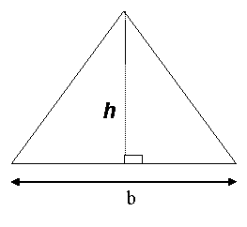

Example: Q16 Area of a Triangle
$$A=\frac{1}{2}bh$$
Q16 AreaOfTriangle(Q16 b, Q16 h) ;
AreaOfTriangle:
SMULL R0,R1,R0,R1 // R1.R0 = Q32.32 product b x h
LSR R0,R0,16 // Extract middle 32 bits
ORR R0,R0,R1,LSL 16
LSR R0,R0,1 // Divide by 2
BX LR
The second LSR can be eliminated by shifting right by 17 bits instead of 16.

Slide 18
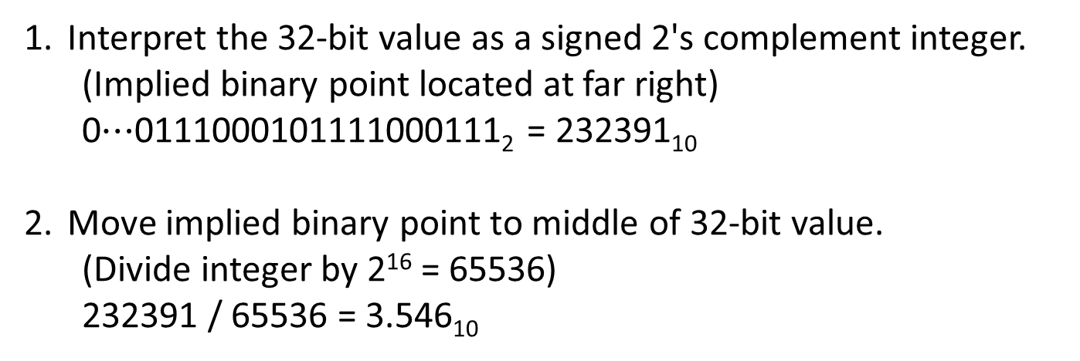
Interpreting a Q16.16 Real
31 |  |  |  |  |  |  |  |  |  |  |  |  |  |  | 16 | 15 |  |  |  |  |  |  |  |  |  |  |  |  |  |  | 0
0 | 0 | 0 | 0 | 0 | 0 | 0 | 0 | 0 | 0 | 0 | 0 | 0 | 0 | 1 | 1 | 1 | 0 | 0 | 0 | 1 | 0 | 1 | 1 | 1 | 1 | 0 | 0 | 0 | 1 | 1 | 1
Implied position of Q16 binary point.
Implied position of integer binary point.
Interpret the 32-bit value as a signed 2's complement integer.
(Implied binary point located at far right)
0$⋯$0111000101111000111₂ = 232391₁₀
Move implied binary point to middle of 32-bit value.
(Divide integer by 2¹⁶ = 65536)
232391 / 65536 = 3.546₁₀

Slide 19
Converting Q16.16 to float
float Q16ToFloat(Q16 x)
{
return x / 65536.0 ;
}
Must be a floating-point constant
NOTE: When not using a floating-point processor, the C run-time library provides a (slow) software emulation of this floating-point division. Avoid using this function in any loop or repetitive computation.

Slide 20
Creating a Q16.16 Real Constant
31 |  |  |  |  |  |  |  |  |  |  |  |  |  |  | 16 | 15 |  |  |  |  |  |  |  |  |  |  |  |  |  |  | 0
Implied position of the binary point.
typedef int32_t Q16 ; // NOTE: Container is an integer
Q16 x = 3.7 ; // NO: truncates to integer 3 (not 3.0)
Q16 x = (int32_t) (65536 * 3.7 + 0.5) ; // YES
Multiply by 2¹⁶ so that binary point is in the middle
For rounding

Slide 21
Converting float to Q16.16
Q16 FloatToQ16(float x)
{
float rounding ;
if (x >= 0.0) rounding = +0.5 ;
else rounding = -0.5 ;
return (int32_t) (65536 * x + rounding) ;
}
NOTE: When not using a floating-point processor, the C run-time library provides a (slow) software emulation of this floating-point calculation. Avoid using this function in any loop or repetitive computation.

Slide 22
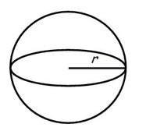

Example: Q16 Volume of a Sphere
$$V= \frac{4}{3}πr^{3}$$
Q16 VolumeOfSphere(Q16 r) ;
VolumeOfSphere:
SMULL R1,R2,R0,R0 // R2.R1 = Q32.32 product r squared
LSR R1,R1,16 // Extract Q16.16 product into R1
ORR R1,R1,R2,LSL 16
SMULL R0,R1,R1,R0 // R1.R0 = Q32.32 product r cubed
LSR R0,R0,16 // Extract Q16.16 product into R0
ORR R0,R0,R1,LSL 16
LDR R1,=274516 // R1 = (4*pi)/3 x 65536
SMULL R0,R1,R0,R1 // R1.R0 = Q32.32 volume
LSR R0,R0,16 // Extract Q16.16 product into R0
ORR R0,R0,R1,LSL 16
BX LR

Slide 23

Q16 ÷ Q16 Division
Dividend (Q16.16)
63
47
32
31
16
0
sign-extension
whole part
fractional part
filled with 0’s
Double-length 64-bit integer dividend
Dividend (Q32.32)
31
0
Divisor (Q16.16)
÷
whole part
32-bit integer divisor
fractional part
The ARM SDIV instruction is only 32 bits ÷ 32 bits
Quotient (Q16.16)
31
0
whole part
32-bit integer quotient
fractional part

Slide 24
Example: Q8 ÷ Q8 Division
+4.25₁₀ = 04.40₁₆ = 1088₁₀ (Q8.8)
÷-3.75₁₀ = FC.40₁₆ = -960₁₀ (Q8.8)
04.40₁₆ = 0004.4000₁₆ = 278528₁₀ (Q16.16)
278528 ÷ -960 = -290.1333… → -290₁₀ (Q8.8)
= -1.1328125₁₀
Real answer = -1.1333… (loss of precision)

Slide 25




Q16.16 × Q16.16 Multiplication
31 |  |  |  |  |  |  | 16 | 15 |  |  |  |  |  |  | 0
$$x$$
Q16.16 variable $x$ has 16 fractional bits
31 |  |  |  |  |  |  | 16 | 15 |  |  |  |  |  |  | 0
× $y$
Q16.16 variable y has 16 fractional bits
63 |  |  |  |  |  |  | 24 | 23 |  |  |  |  |  |  | 32 | 31 |  |  |  |  |  |  | 16 | 15 |  |  |  |  |  |  | 0
$$xy$$
Thus the 64-bit Q32.32 product will have 32 fractional bits
LDR R0,x // R0 ← x (Q16.16)
LDR R1,y // R1 ← y (Q16.16)
SMULL R0,R1,R0,R1 // R1.R0 ← xy (Q32.32)
LSR R0,R0,16 // Extract middle 32 bits
ORR R0,R0,R1,LSL 16
STR R0,z // R0 → z (Q16.16)
6 instructions,
6 clock cycles

Slide 26


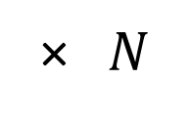
Multiplying Q16.16 by Q32.0 Integer
31 |  |  |  |  |  |  | 16 | 15 |  |  |  |  |  |  | 0
$$x$$
Q16.16 variable $x$ has 16 fractional bits
31 |  |  |  |  |  |  |  |  |  |  |  |  |  |  | 0
× $N$
Q32.0 integer N has 0 fractional bits
63 |  |  |  |  |  |  | 24 | 23 |  |  |  |  |  |  | 32 | 31 |  |  |  |  |  |  | 16 | 15 |  |  |  |  |  |  | 0
$$Nx$$
The 64-bit Q0.32 product will have 32 fractional bits
LDR R0,x // R0 ← x (Q16.16)
LDR R1,N // R1 ← N (Q32.0)
MUL R0,R0,R1 // R0 ← Nx (Q16.16)
STR R0,y // R0 → y
4 instructions,
4 clock cycles

Slide 27




Multiplying Q16.16 by Q0.32 Fraction
31 |  |  |  |  |  |  | 16 | 15 |  |  |  |  |  |  | 0
$$x$$
Q16.16 variable $x$ has 16 fractional bits
31 |  |  |  |  |  |  |  |  |  |  |  |  |  |  | 0
× $F$
Q0.32 fraction F has 32 fractional bits
63 |  |  |  |  |  |  | 24 | 23 |  |  |  |  |  |  | 32 | 31 |  |  |  |  |  |  | 16 | 15 |  |  |  |  |  |  | 0
$$Fx$$
The 64-bit product will have 48 fractional bits (Q16.48) → Use most-significant half of product
LDR R0,x // R0 ← x (Q16.16)
LDR R1,F // R1 ← F (Q0.32)
SMULL R0,R1,R0,R1 // R1.R0 ← Fx (Q16.48)
STR R1,y // R0 → y (Q16.16)
4 instructions,
4 clock cycles

Slide 28
Constant Multiples of a Q16
The Q16 format is really data type int32_t, so we can create multiples of Q16 values the same way we create multiples of integer values.
LDR R0,x // R0 ← x (in Q16 format)
RSB R0,R0,R0,LSL 3 // R0 ← 8x – 1x = 7x
STR R0,y // R0 → y (in Q16 format)
Calculation | As Integer | Q16
R0 | 245,760 | +3.75
R0,LSL 3 | 1,966,080 | +30.00
R0,LSL 3 – R0 | 1,720,320 | +26.25

Slide 29



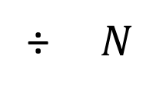
Dividing Q16.16 by a Q32.0 Integer
31 |  |  |  |  |  |  | 16 | 15 |  |  |  |  |  |  | 0
$$x$$
Q16.16 variable $x$ has 16 fractional bits
31 |  |  |  |  |  |  | 16 | 15 |  |  |  |  |  |  | 0
÷ $N$
Q32.0 integer N has 0 fractional bits
31 |  |  |  |  |  |  | 16 | 15 |  |  |  |  |  |  | 0
$$x/N$$
The 32-bit Q16.16 quotient will have 16 fractional bits
LDR R0,x // R0 ← x (in Q16 format)
LDR R1,N // R1 ← N (in Q0 format)
SDIV R0,R0,R1 // R0 ← x/N (in Q16 format)
STR R0,y // R0 → y

Slide 30
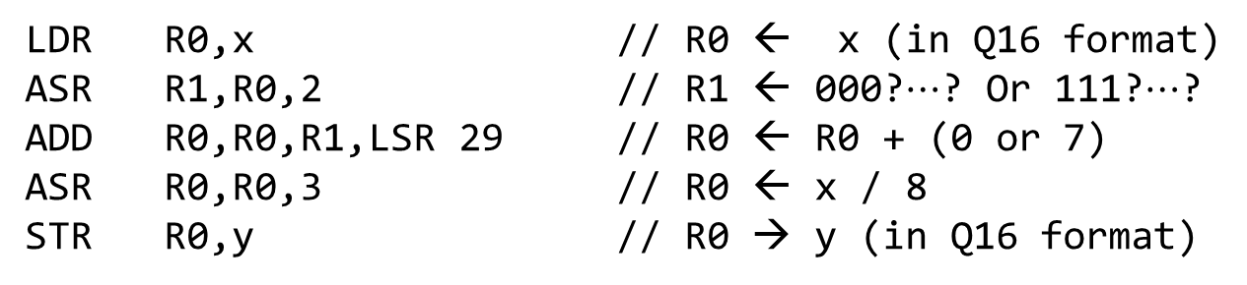
Dividing Q16.16 by Integer Constant
The Q16 format is really data type int32_t, so we can use the same technique for dividing by a constant that we used for integer values.
LDR R0,x // R0 ← x (in Q16 format)
ASR R1,R0,2 // R1 ← 000?$⋯$? Or 111?$⋯$?
ADD R0,R0,R1,LSR 29 // R0 ← R0 + (0 or 7)
ASR R0,R0,3 // R0 ← x / 8
STR R0,y // R0 → y (in Q16 format)

Slide 31
Q32.32 FORMAT
Range of Q16.16 is only ±32768
Resolution of Q16.16 is only ~1.5×10⁻⁵
Next convenient choice is Q32.32
Q32.32 Add/Subtract takes only 2 instructions
Q32.32 Multiplication can be made efficient
Q32.32 Division is difficult to impossible
Most divisors are constants → Multiply by 1/K
Used in SONY Playstation

Slide 32
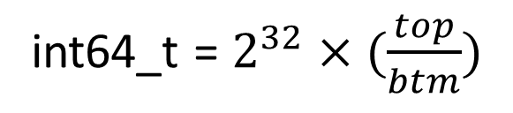
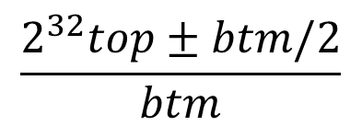
Creating Q32 Constants (w/out FP)
Multiplication before integer division!
Choose sign to increase the magnitude of top
Real number expressed as a ratio of two integers
int64_t = $2^{32}×(\frac{top}{btm})$
$$\frac{2^{32}top±btm/2}{btm}$$
The Q32 representation of 1.0 is 0000 0001 0000 0000₁₆
This 64-bit division requires executing a loop on a 32-bit CPU, so limit how frequently function Q32Ratio is called.
typedef int64_t Q32 ;
Q32 Q32Ratio(int32_t top, int32_t btm)
{
int32_t rounding = (top >= 0) ? +btm/2 : -btm/2 ;
return (((Q32) top << 32) + rounding) / btm ;
}

Slide 33
Printing Q32 Values (w/out FP)
void PrintQ32(Q32 x)
{
int k ;
if (x < 0) { putchar('-') ; x = -x ; }
printf("%u", Upper32Bits(x)) ;
putchar('.') ;
for (k = 0; k < 5; k++)
{
Upper32Bits(x) = 0 ;
x = 10 * x ;
printf(“%d”, Upper32Bits(x)) ;
}
}
Decimal values must be printed in sign+magnitude.
Print magnitude of the integer part.
"5" is the number of fractional digits to print.
Print magnitude of the fractional part.

Slide 34
Q32.32 × Q32.32 Multiplication
Must be fast – no loops!
Strategy:
Compute: 128 bits ← 64 bits × 64 bits (unsigned)
Convert unsigned product to 2’s complement
Extract the middle 64 bits

Slide 35
Decomposing Unsigned Integer Multiplication
Break the decimal number 1234 into two halves:
1234₁₀ = 10²×12 + 34 = 1200 + 34
Break a 64-bit unsigned integer into two 32-bit halves:
A_{U} = 2³²A_{HI} + A_{LO} = A_{HI}00…………0 + A_{LO}
Then the 128-bit product of two 64-bit unsigned integers is:
A_{U}B_{U} = (2³²A_{HI} + A_{LO}) (2³²B_{HI} + B_{LO})
= 2⁶⁴A_{HI}B_{HI} + 2³²(A_{HI}B_{LO} + A_{LO}B_{HI}) + A_{LO} B_{LO}
32 zeroes
Each partial product is 64 bits ← 32 bits x 32 bits (use UMULL instruction)

Slide 36
64×64 Unsigned Integer Multiplication
63
0
Add A_{HI}B_{HI} to bits 127-64 of result
A_{HI}B_{HI}
63
0
+
A_{HI}B_{LO}
Add A_{HI}B_{LO} and A_{LO}B_{HI} to bits 95-32 of result and propagate any carries
63
0
+
A_{LO}B_{HI}
63
0
+
A_{LO}B_{LO}
127
0
A_{U}B_{U}

Slide 37
Example Using 8-Bit Operands
A_{U} = 11101000₂ (232₁₀) Note: 232₁₀×44₁₀ = 10208₁₀
B_{U} = 00101100₂ ( 44₁₀)
A_{HI} = 1110₂ (14₁₀) A_{LO} = 1000₂ ( 8₁₀)
B_{HI} = 0010₂ ( 2₁₀) B_{LO} = 1100₂ (12₁₀)
A_{U}B_{U} = 2⁸A_{HI}B_{HI} + 2⁴(A_{HI}B_{LO} + A_{LO}B_{HI}) + A_{LO}B_{LO}
= 2⁸×14×2 + 2⁴(14×12 + 8×2) + 8×12
= 256×28 + 16×(168 + 16) + 96
= 7168 + 2944 + 96 = 10208₁₀

Slide 38
Convert Result to 2’s Complement
Polynomial interpretation for unsigned:
A_{U} = 2⁶³A₆₃ + 2⁶²A₆₂ + … 2⁰A₀
Polynomial interpretation for 2’s complement:
A_{S} = -2⁶³A₆₃ + 2⁶²A₆₂ + … 2⁰A₀
Thus: A_{S} = A_{U} - 2×2⁶³A₆₃ A₆₃ = sign bit
A_{S} = A_{U} when A ≥ 0
= A_{U} - 2⁶⁴ when A < 0

Slide 39
Convert Result to 2’s Complement
A_{S} | B_{S} | Signed 2’s complement product (A_{S}B_{S})
≥ 0 | ≥ 0 | A_{S}B_{S} = A_{U}B_{U}
≥ 0 | < 0 | A_{S}B_{S} = A_{U}(B_{U} – 2⁶⁴) = A_{U}B_{U} – 2⁶⁴A_{U}
< 0 | ≥ 0 | A_{S}B_{S} = (A_{U} – 2⁶⁴)B_{U} = A_{U}B_{U} – 2⁶⁴B_{U}
< 0 | < 0 | A_{S}B_{S} = (A_{U} – 2⁶⁴)(B_{U} – 2⁶⁴) = A_{U}B_{U} – 2⁶⁴A_{U} – 2⁶⁴B_{U} + 2¹²⁸
If A_{S} < 0, subtract all 64 bits of B_{U} from the most-significant half of the 128-bit unsigned product A_{U}B_{U}
If B_{S} < 0, subtract all 64 bits of A_{U} from the most-significant half of the 128-bit unsigned product A_{U}B_{U}
Discard: 2¹²⁸ doesn’t affect 128-bit result

Slide 40
Convert Result to 2’s Complement
127
0
A_{U}B_{U}
63
0
If A <0, subtract B from the most-significant half of unsigned product
−
A₆₃×B
63
0
If B <0, subtract A from the most-significant half of unsigned product
−
B₆₃×A
127
0
A_{S}B_{S}

Slide 41
Example Using 8-Bit Operands
A_{S} = 11101000₂ (-24₁₀) Note: -24₁₀×44₁₀ = -1056₁₀
B_{S} = 00101100₂ (+44₁₀)
A_{U}B_{U} = 0010 0111 1110 0000₂ (10208₁₀)
─ 0010 1100
A_{S}B_{S} = 1111 1011 1110 0000₂ (-1056₁₀)
A_{S} < 0 → subtract B from MS half

Slide 42
Example Using 4.4 Operands
A_{S} = 1110.1000₂ (-1.50₁₀) Note: -1.50₁₀×2.75₁₀ = -4.125₁₀
B_{S} = 0010.1100₂ (+2.75₁₀)
A_{U}B_{U} = 0010 0111 1110 0000₂ (10208₁₀)
─ 0010 1100
A_{S}B_{S} = 1111 1011 1110 0000₂ (-1056₁₀)
1011.1110₂ (-4.125₁₀)
A_{S} < 0 → subtract B from MS half

Slide 43
Q32.32 × Q32.32 Multiplication
// int64_t Q32Product(int64_t A, int64_t B)
// A is in register pair R1.R0 (R1=MSW(A), R0=LSW(A))
// B is in register pair R3.R2 (R3=MSW(B), R2=LSW(B))
Q32Product:
PUSH {R4} // Preserve R4
// Compute R12.R4 = middle of 128-bit unsigned product
UMULL R12,R4,R0,R2 // LSW:R4 = MSHalf of LSW(A)xLSW(B)
MUL R12,R1,R3 // MSW:R12 = LSHalf of MSW(A)xMSW(B)
UMLAL R4,R12,R0,R3 // R12.R4 += 64 bits of LSW(A)xMSW(B)
UMLAL R4,R12,R1,R2 // R12.R4 += 64 bits of MSW(A)xLSW(B)
// Convert unsigned result to signed and leave in R1.R0
AND R1,R2,R1,ASR 31 // R1 = (A < 0) ? LSW(B) : 0
SUB R12,R12,R1 // R12 = (A < 0) ? (R12 – LSW(B)) : R12
AND R3,R0,R3,ASR 31 // R3 = (B < 0) ? LSW(A) : 0
SUB R1,R12,R3 // R1 = (B < 0) ? (R12 – LSW(A)) : R12
MOV R0,R4 // Copy LSW(result) to R0
POP {R4} // Restore R4
BX LR // Return to calling program.
R12
R4
UMULL
A_{LO}B_{LO}
MUL
A_{HI}B_{HI}
UMLAL
+ A_{LO}B_{HI}
UMLAL
+ A_{HI}B_{LO}
A_{U}B_{U}
AND/SUB
– B_{LO}
AND/SUB
– A_{LO}
A_{S}B_{S}
Execution Time: 17 clock cycles

Slide 44

Q32.32 × Q32.0 Multiplication B is an Integer (B_{LO} = 0)
63
0
A_{HI}B_{HI}
63
0
+
A_{HI}B_{LO}
63
0
+
A_{LO}B_{HI}
63
0
+
A_{LO}B_{LO}
127
0
A_{U}B_{U}
63
0
−
A₆₃×B
The bits we would normally keep here are those of B_{LO}, which happen to be all 0’s.
63
0
−
B₆₃×A
127
0
A_{S}B_{S}
Keep only middle 64 bits

Slide 45
Q32.32 × Q32.0 Multiplication B is an Integer (B_{LO} = 0)
R3
R12
UMULL
A_{LO} B_{HI}
// int64_t Q32xInteger(int64_t A, int32_t Bhi)
Q32xInteger:
UMULL R12,R3,R0,R2 // R3.R12 = Alo x Bhi
MLA R3,R1,R2,R3 // R3 += Ahi x Bhi
AND R2,R0,R2,ASR 31 // R2 = Bhi<0 ? Alo : 0
SUB R1,R3,R2 // R1 = R3–R2 (MSHalf)
MOV R0,R12 // R0 = LSHalf of product
BX LR
MLA
A_{HI}B_{HI}
A_{U}B_{U}
AND/SUB
– A_{LO}
A_{S}B_{S}
Execution Time: 9 clock cycles (vs 17)
R1
R0
Note: There is a similar savings when B is a purely fractional value (B_{HI} = 0)

Slide 46
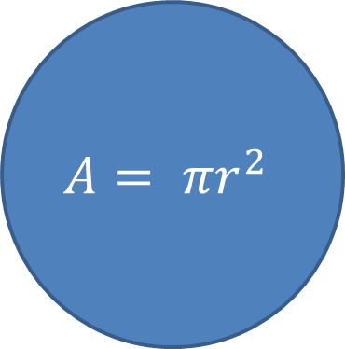
Example: Area of a Circle
$$A= πr^{2}$$
Q32 CircleArea(Q32 radius)
{
Q32 pi = Q32Ratio(314159, 100000) ;
Q32 rSquared = Q32Product(radius, radius) ;
return Q32Product(pi, rSquared) ;
}

Slide 47
Example: Discriminant
Q32 Discriminant(Q32 a, Q32 b, Q32 c)
{
Q32 bSquared = Q32Product(b, b) ;
Q32 ac = Q32Product(a, c) ;
return bSquared – (ac << 2) ;
}
4 × a × c
Regular addition and subtraction operators work.
Left-shift works to multiply by 2^{k} because we are using a fixed-point representation. (Won’t work with floating-point!)

Slide 48
Example: Average
Q32 Average(Q32 a[], int32_t n)
{
Q32 total ;
int32_t k ;
total = 0 ;
for (k = 0; k < n; k++)
{
total += a[k] ;
}
return Q32Ratio(total, n) ;
}

Slide 49
Q32.32 ÷ Q32.32 Division
Dividend (Q32.32)
127
95
64
63
32
0
sign-extension
whole part
fractional part
filled with 0’s
Double-length 128-bit integer dividend
63
0
Divisor (Q32.32)
Cannot be decomposed into a straight-line sequence of 32-bit ARM divide instructions
Must use a loop (64 iterations)
Implement unsigned 128 ÷ 64
Use wrapper function for signed
÷
whole part
64-bit integer divisor
fractional part
Quotient (Q32.32)
63
0
whole part
64-bit integer quotient
fractional part

Slide 50
Q32.32 ÷ Q32.32 Division Wrapper Function for Signed #’s
extern uint64_t UQ32Quotient(uint64_t dividend, uint64_t divisor) ; #define MSWord(x) ((int32_t *) &x)[1] int64_t Q32Quotient(int64_t dividend, int64_t divisor) { uint64_t quotient ; int negate = 0 ; if ((MSWord(dividend) ^ MSWord(divisor)) < 0) negate = 1 ; if (dividend < 0) dividend = -dividend ; if (divisor < 0) divisor = -divisor ; quotient = UQ32Quotient((uint64_t) dividend, (uint64_t) divisor) ; return negate ? –((int64_t) quotient) : (int64_t) quotient ; }

Slide 51
Unsigned Division: N-Bits ÷ N-Bits
Example: 4-bit dividend ÷ 4-bit divisor = 13₁₀ ÷ 2₁₀ = 1101₂ ÷ 0010₂
0110
0010 1101 0010 0001101
0010
0011
0010
0010
0010
0001
0010
0001
Quotient = 6
We must prepend three 0’s to the dividend in order to compare the divisor to the first dividend digit.
(1) Divisor > dividend, so don’t subtract; quotient bit = 0
(2) Divisor ≤ dividend, so subtract; quotient bit = 1
(3) Divisor ≤ dividend, so subtract; quotient bit = 1
Remainder = 1
(4) Divisor > dividend, so don’t subtract; quotient bit = 0

Slide 52
Unsigned Division: N-Bits ÷ N-Bits
MS Bit of Quotient
Example: 4-bit dividend ÷ 4-bit divisor = 13₁₀ ÷ 2₁₀ = 1101₂ ÷ 0010₂
Zero-Extend dividend to 2N bits: 0000 1101
Shift dividend left 1 bit: 0001 1010 MSW(dividend) < divisor, do nothing
Shift dividend left 1 bit: 0011 0100 MSW(dividend) ≥ divisor, subtract divisor, add 1 -0010+0001
0001 0101
Shift dividend left: 0010 1010 MSW(dividend) ≥ divisor, subtract divisor, add 1 -0010+0001
0000 1011
Shift dividend left : 0001 0110 MSW(dividend) < divisor, do nothing
4-bit divisor
Repeat 4 times
Remainder = 1
Quotient = 6

Slide 53
#define MSWord(x) ((uint32_t *) &x)[1] uint64_t UQ32Quotient(uint64_t dividend, uint64_t divisor) { uint64_t upper64, lower64 ; // 128-bit unsigned dividend int k // Put 64-bit dividend in middle of 128 bits upper64 = (uint64_t) MSWord(dividend) ; lower64 = dividend << 32 ; // if (upper64 >= divisor) OVERFLOW! for (k = 0; k < 64; k++) { // The next 3 lines of code shift // a 128-bit value left by 1 bit upper64 <<= 1 ; if (MSWord(lower64) & 0x80000000) upper64 |= 1 ; lower64 <<= 1 ; if (upper64 >= divisor) { upper64 -= divisor ; lower64 |= 1 ; } } // upper64 = Remainder, lower64 = Quotient return lower64 ; }
UNSIGNED Q32 ÷ Q32 DIVISION
Overflow is now possible for more than a zero divisor
Execution time = O(n), where n = # bits (64)
Use reciprocal multiplication whenever possible!

Slide 54
// uint64_t UQ32Quotient(uint64_t dividend, uint64_t divisor) .global UQ32Quotient UQ32Quotient: PUSH {R4,R5} LDR R5,=0 // upper64 = MSW(dividend) MOV R4,R1 MOV R1,R0 // lower64 = LSW(dividend) << 32 LDR R0,=0 LDR R12,=0 // k = 0 L1: CMP R12,64 // k < 64 ? BHS L4 LSL R5,R5,1 // upper64.lower64 <<= 1, C = MSbit ORR R5,R5,R4,LSR 31 LSL R4,R4,1 ORR R4,R4,R1,LSR 31 LSL R1,R1,1 ORR R1,R1,R0,LSR 31 LSL R0,R0,1 CMP R5,R3 // if upper64 > divisor, goto L2 BHI L2 BLO L3 CMP R4,R2 BLO L3 L2: SUBS R4,R4,R2 // upper64 -= divisor SBC R5,R5,R3 ORR R0,R0,1 // lower64 |= 1 L3: ADD R12,R12,1 // k++ B L1 // repeat L4: POP {R4,R5} BX LR // Return (quotient in lower64) .end
Q32÷Q32 DIVISION
Assembly for unsigned 128 ÷ 64

